Slide 1

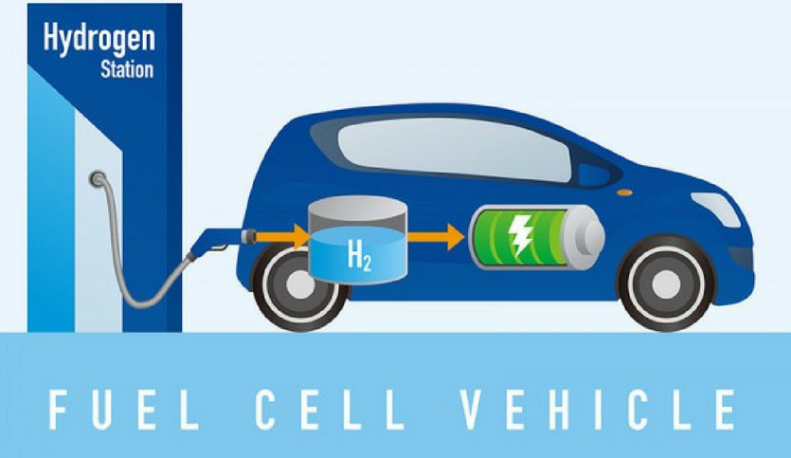
Goals Develop a program that generates corner test cases for autonomous fuel cell vehicles, which assists in verifying the safety of controllers and thus helps overcome one challenging difficulty that barriers autonomous vehicles from being marketed. The program will be focused on fuel cell vehicles, which will gain increasing popularity due to its environmental-friendliness. | Technical difficulties Not familiar with how to describe fuel cell vehicle models Not familiar with the concepts of controlled invariant sets and backward reachable sets. Not familiar with using the SCOTS software. Not familiar with using the program generating corner cases.
Objectives Correctly derive the differential equation system for fuel cell vehicle models. Correctly use the SCOTS software to compute the symbolic models and controlled invariant sets via value iteration method. Correctly implement a program converting the outputs of SCOTS into .mat files. | Approach Read relevant papers describing fuel cell vehicle models. Read relevant papers concerning computing controlled invariant sets via value iteration and try examples mentioned in the paper. Read the manual of SCOTS and try examples in the git repository. Read relevant papers concerning the algorithm of generating corner cases using controller synthesis.

Slide 2
(Perhaps) helpful references:
G. Chou, Y. E. Sahin, L. Yang, K. J. Rutledge, P. Nilsson and N. Ozay, “Using Control Synthesis to Generate Corner Cases: A Case Study on Autonomous Driving”
P. Nilsson, O. Hussien, A. Balkan, Y. Chen, A. D. Ames, J. W. Grizzle, N. Ozay, H. Peng, and P. Tabuada. Correct-by-construction adaptive cruise control: Two approaches. IEEE Trans. on Control Systems Technology, 24(4):1294–1307, 2016.
L. Yang, D. Rizzo, M. Castanier and N. Ozay. “Parameter Sensitivity Analysis of Controlled Invariant Sets via Value Iteration”
M. Rungger and M. Zamani, “SCOTS: A Tool for the Synthesis of Symbolic Controllers”
Siegel, J.B., Stefanopoulou, A.G., Rizzo, D., and Prakash, N., “Cooling Parasitic Considerations for Optimal Sizing and Power Split Strategy for Military Robot Powered by Hydrogen Fuel Cells,” SAE Technical Paper 2018-01-0798, 2018, doi:10.4271/2018-01-0798.

